Slide 1
DATABASE
UNIT 2

Slide 2
Agenda
How to Use a Database,
Working With a Database ,
Using SQL to Query a Database,
Python and SQLite,
Creating an SQLite DB,
Pulling Data from a DB,
SQLite Database Files

Slide 3
How to Use a Database
A database (DB) is simply a collection of data, placed into an arbitrary structured format. The most common DB is a relational database; tables are used to store the data and relationships can be defined between different tables.
SQL (Structured Query Language) is the language used to work with most DBs.
SQL provides the commands to query a database and retrieve or manipulate information.
An improper query won’t return the desired information, or worse, it will return the wrong information.
SQL is also used to input information into a DB.
Python DB-API (database application programming interface).

Slide 4


Working With a Database
Goal : Create an customer database and table for performing different database operations.
Step 1:
Step 2:
Step 3:

Slide 5
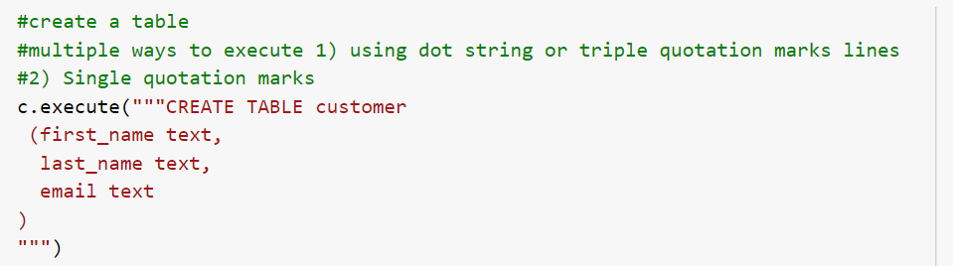


Step 4:
Step 5:
Step 6:

Slide 6
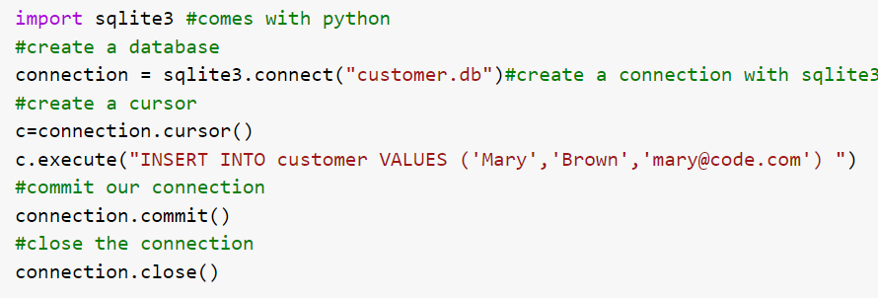
Inserting single record into customer database
Insert the following records:
'Tim','Smith','tim@code.com'
'Mary','Brown','mary@code.com'

Slide 7
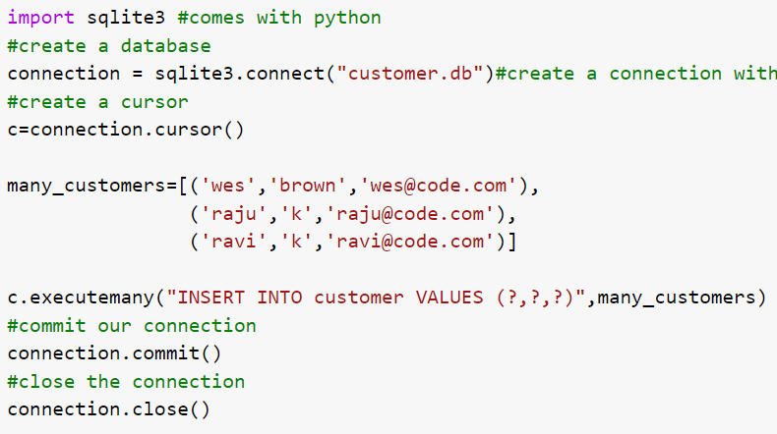
Inserting multiple record

Slide 8
Query options
Fetchone()
Fetchmany()
Fetchall()

Slide 9
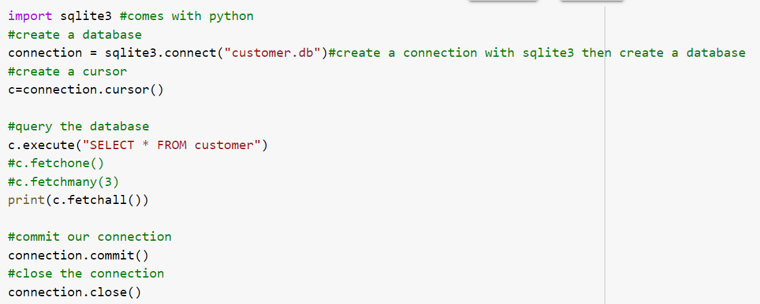

Query customer table using fetchall()
Fetchall() – fetches all the rows from the table.

Slide 10
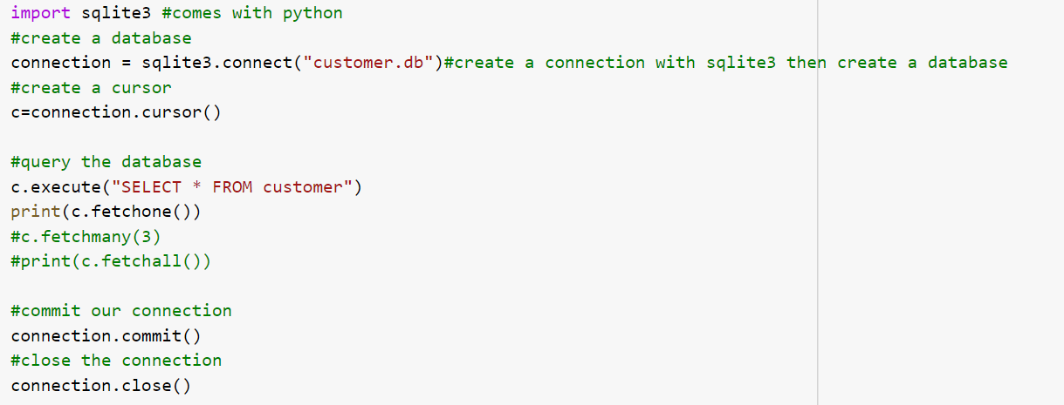
Query customer table using fetchone()
Fetchone()- fetches the 1st row from the table

Slide 11
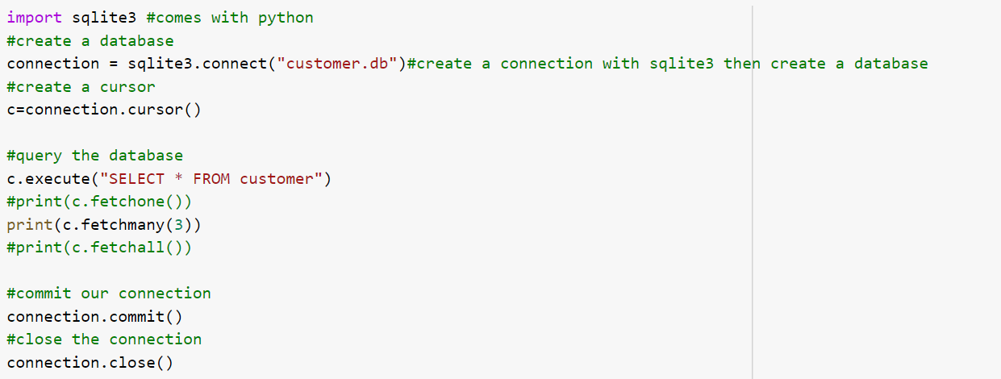
Query customer table using fetchmany()
Fetchmany()- fetches the rows based on argument.

Slide 12
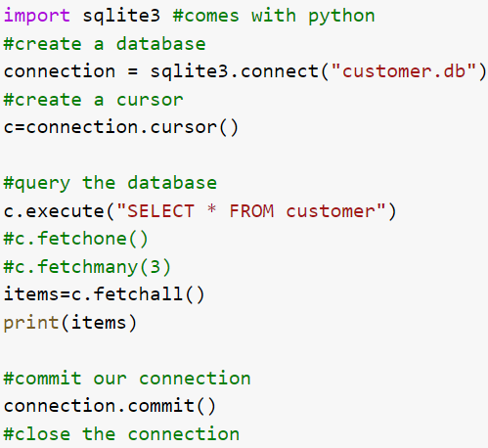
Different way in which fetchall() can be used.

Slide 13
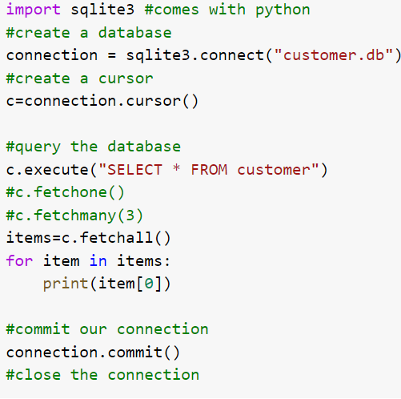

Query customer table and print employee first_name’s

Slide 14
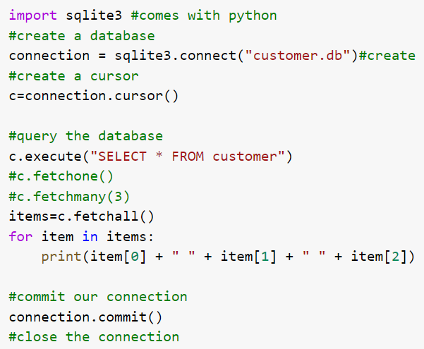
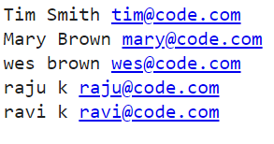
Query customer table and print employee first_name, lastname and email id

Slide 15
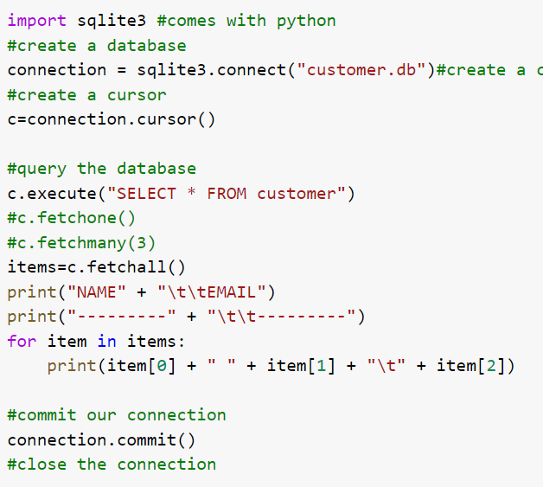
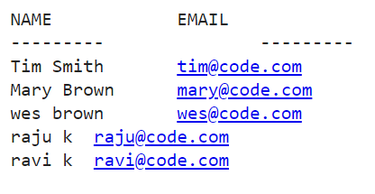
Format the result

Slide 16
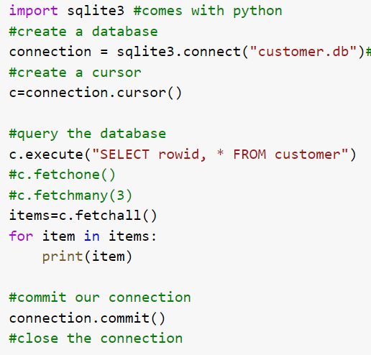
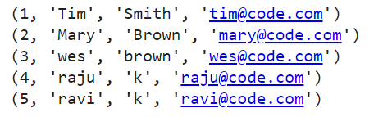
Print the rowid (primary key)

Slide 17
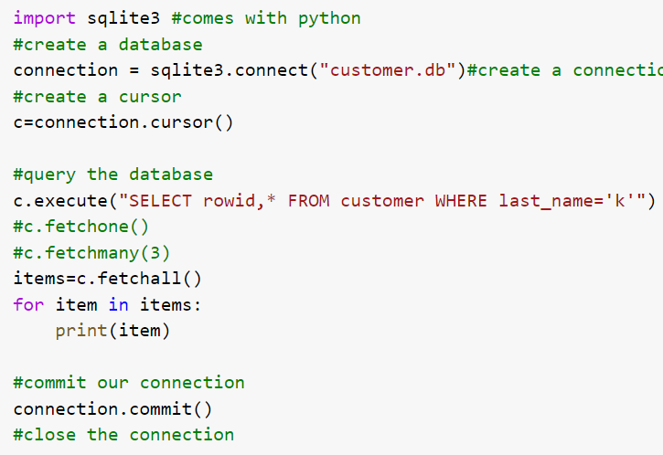

WHERE clause
Print the rows where last_name=‘k’ using Where clause

Slide 18
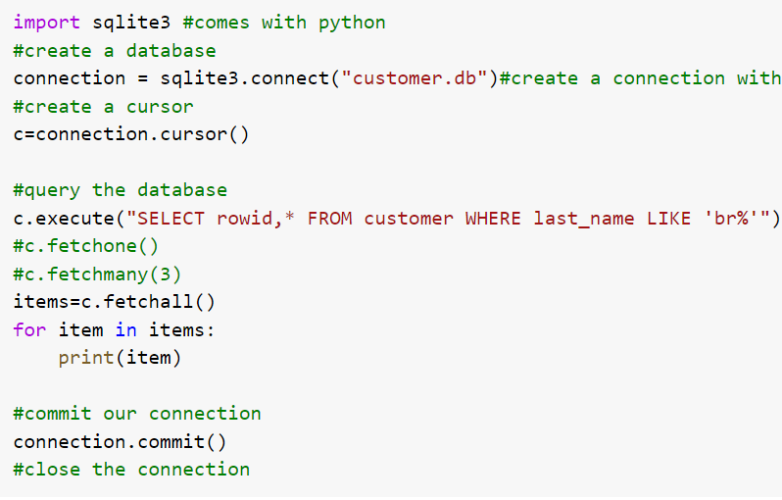

Print the rows where last_name LIKE ‘br%’ using Where clause

Slide 19
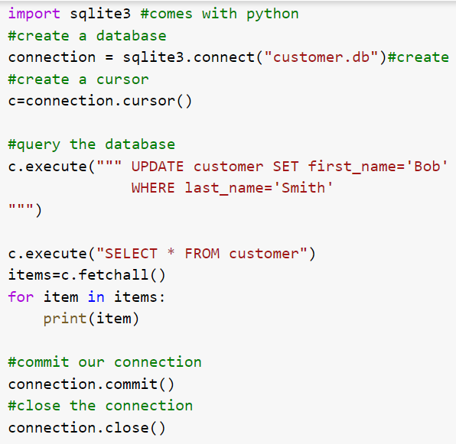
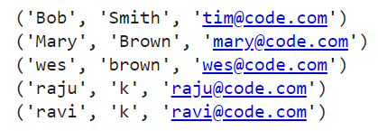
UPDATE RECORDS
Update Customer table with firstname as ‘Bob’ where lastname is ‘Smith’

Slide 20
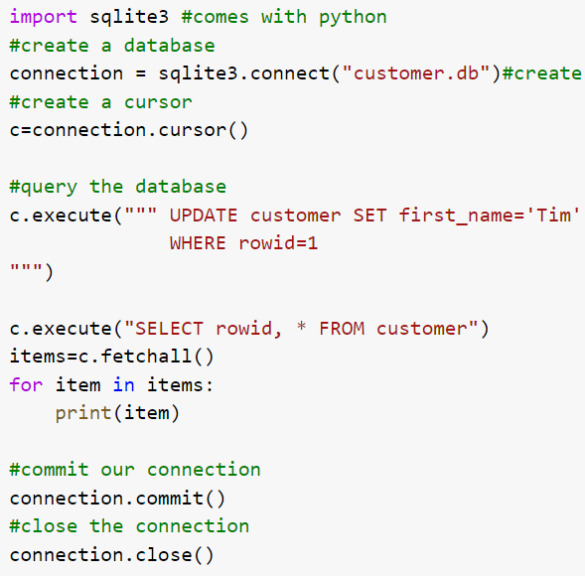
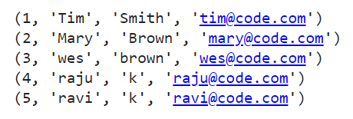
Update Customer table with firstname as ‘Tim’ where rowid is 1

Slide 21
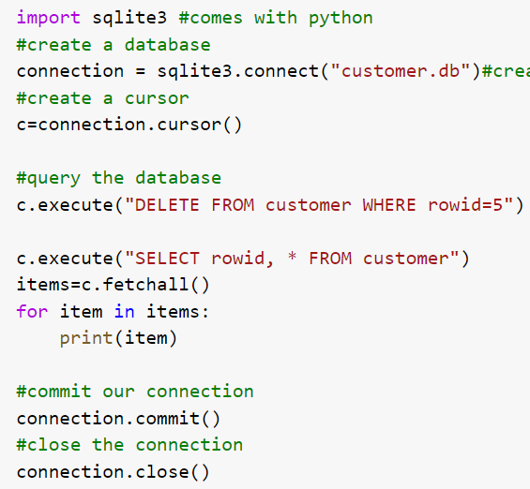
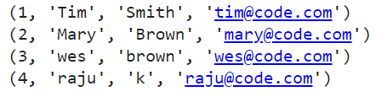
Delete Record
Delete instance where rowid is 5 and print the remaining rows

Slide 22
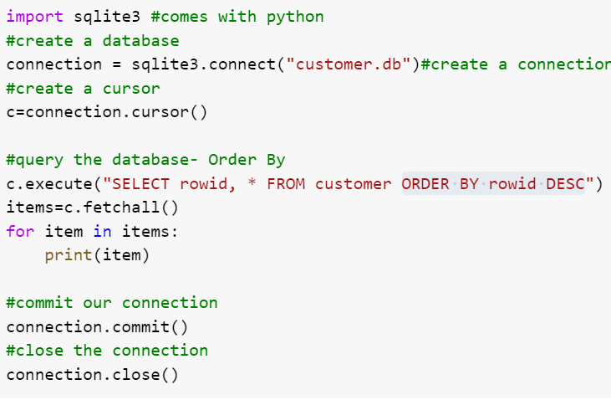
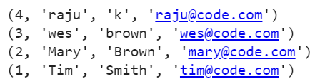
Order Result By

Slide 23
